Slide 1
Home automation
venkateshwar

Slide 2
description
A basic home automation has been done for blind people. With the help of this prototype we can implement it in real life. In this prototype I have used PIR sensor, Servo motor, DC motor, Tilt sensor, Arduino and buzzer. When the blind people stand near their house door PIR sensor sense the human presence and with the help of tilt sensor they tilt it and the door opens up for opening of door I have used servo motor. If they want to switch on the fan they can use these tilt sensor to switch it on. With the help of buzzer they can realise that the door is open or close.

Slide 3
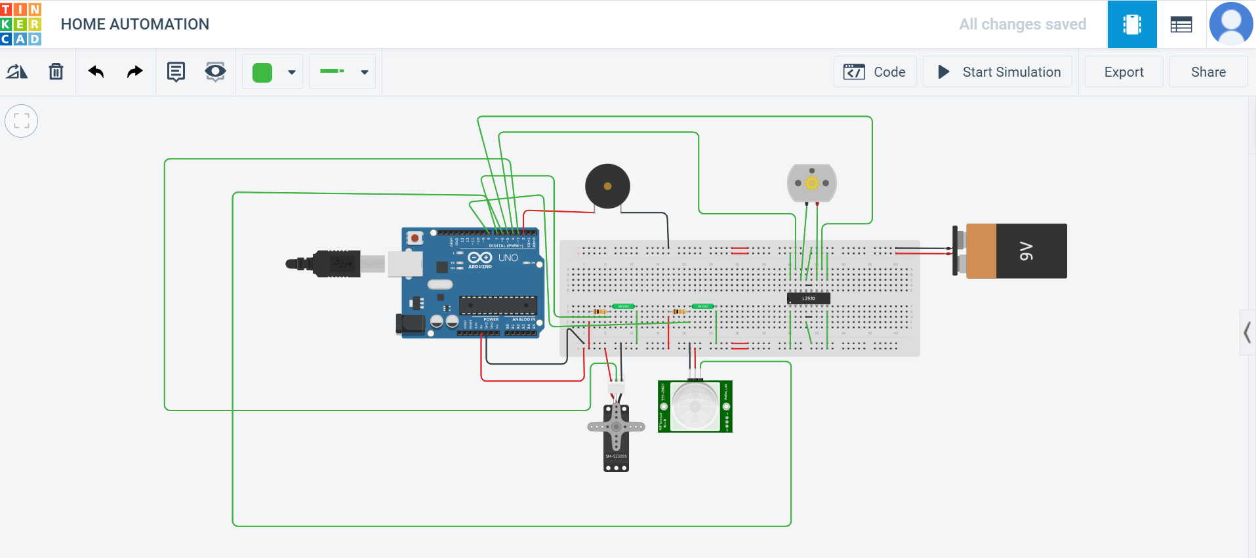
Circuit design

Slide 4
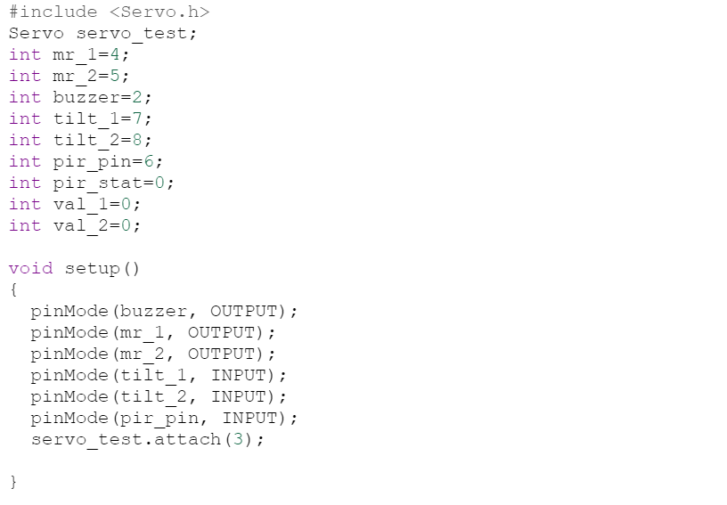
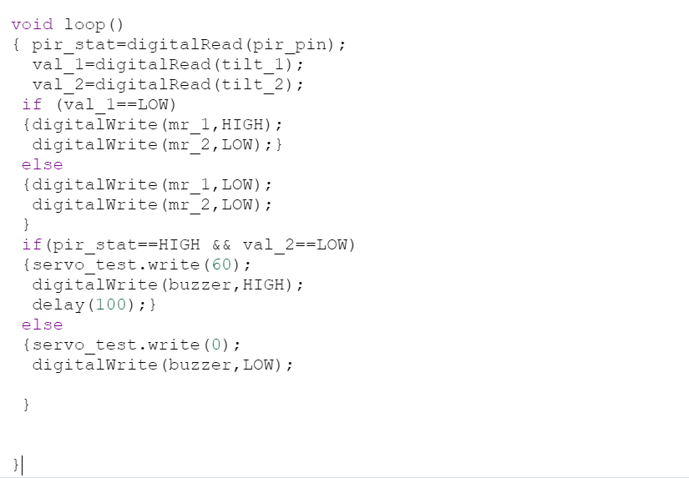
code

Slide 5
simulation
https://www.tinkercad.com/things/gAvTXnMjDVm-smashing-hango-tumelo/editel?tenant=circuits

Slide 6
Thank you

